Slide 1
Wine Quality Prediction
Suhas S (2348563)
Shreyansh Jaiswal (2348558) Nagaraju Naveen Kumar Varma(2348535)
Department of Computer Science)
Christ (Deemed to be University
Banglore, India

Slide 2
Agenda
Data Analysis & Feature Engineering
Modeling & Metric Evaluation

Slide 3
Data Overview
The data is Vinho Verde* white wine samples from Portugal.
The goal of this project is to determine wine quality based on the chemical properties
The data consist of 1599 rows and 12 columns
Input variable: based on physicochemical tests
Output variable: based on sensory data, median of at least 3 evaluations made by wine experts
*Portuguese wine that originated in the historic Minho province in the far north of the country

Slide 4
Features
Fixed Acidity: Most acids involved with wine or fixed or nonvolatile
Volatile Acidity: The amount of acetic acid in wine
Citric Acid: Found in small quantities, citric acid can add 'freshness' and flavor to wines
Residual Sugar: The amount of sugar remaining after fermentation stops
Chlorides: The amount of salt in the wine
Free Sulfur Dioxide: The free form of SO2 exists in equilibrium between molecular SO2 (as a dissolved gas) and bisulfite ion
Total Sulfur Dioxide: Amount of free and bound forms of S02
Density: The density of water is close to that of water depending on the percent alcohol and sugar content
pH: Describes how acidic or basic a wine is on a scale from 0 (very acidic) to 14 (very basic)
Sulphates: A wine additive which can contribute to sulfur dioxide gas (S02) levels
Alcohol: The percent alcohol content of the wine
Quality: Output variable (based on sensory data, score between 0 and 10)

Slide 5
Workflow
Wine Quality Data Import
Checking for missing values
Binning (good, bad)
Encoding
Normalization
Class Balance Using stratify
Splitting Dataset
Data Visualization
Modeling
Predictions
Model Comparison

Slide 6
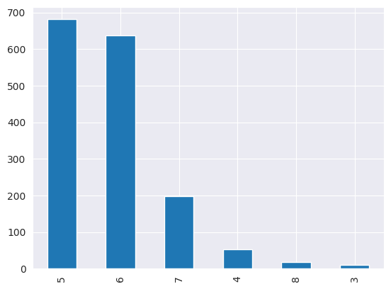
Label Distribution
Quality is represented by scores ranging from 0 to 10
0 is the worst and 10 is the best

Slide 7
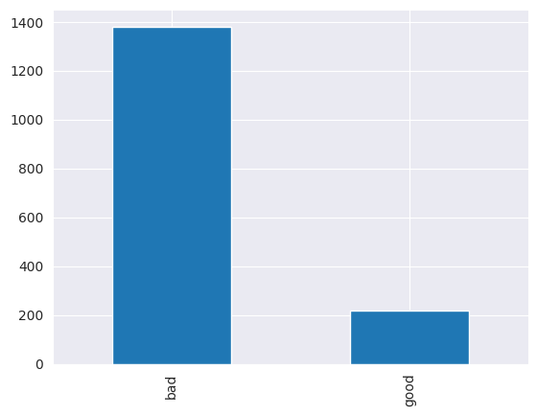
Labels and Encoding
Binning:
○ score of 2 to 6.5 → “Bad”
○ score of 6.5 to 8 → “Good”

Slide 8
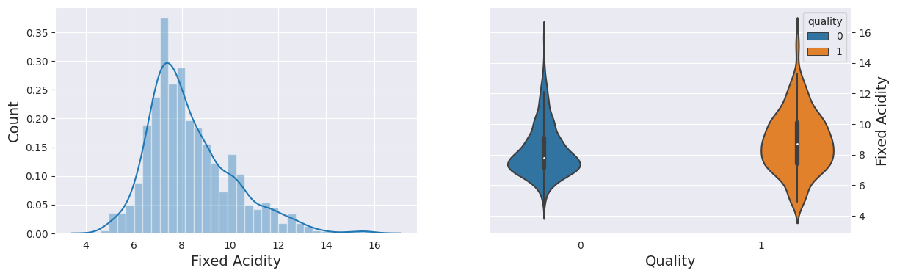
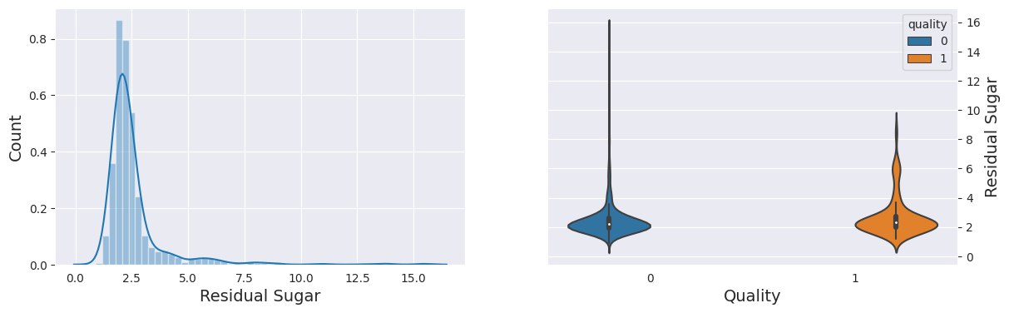
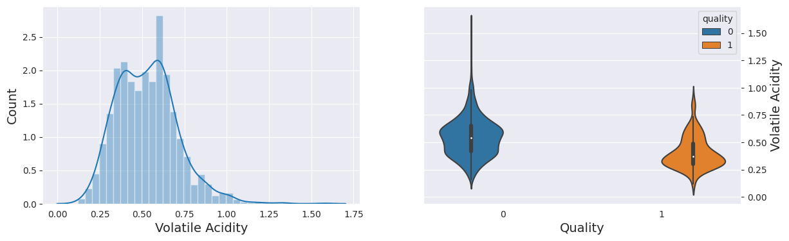
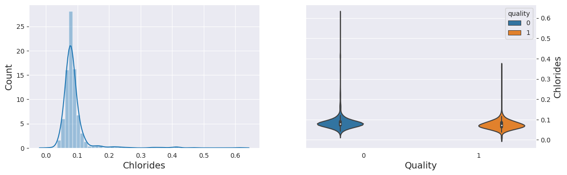
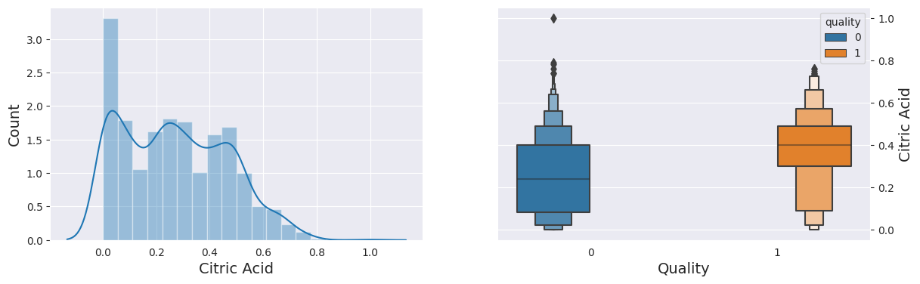
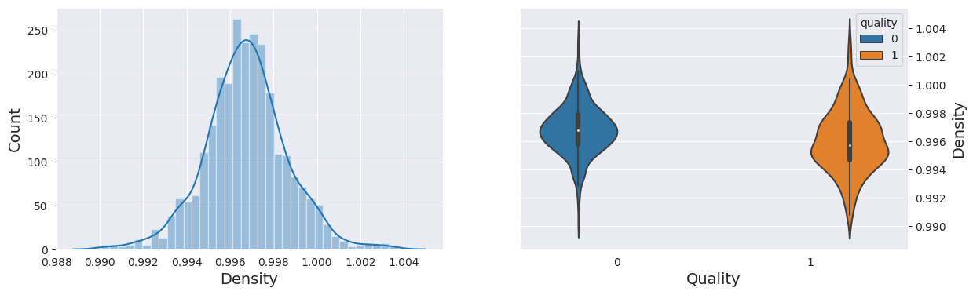
Data Visualization

Slide 9
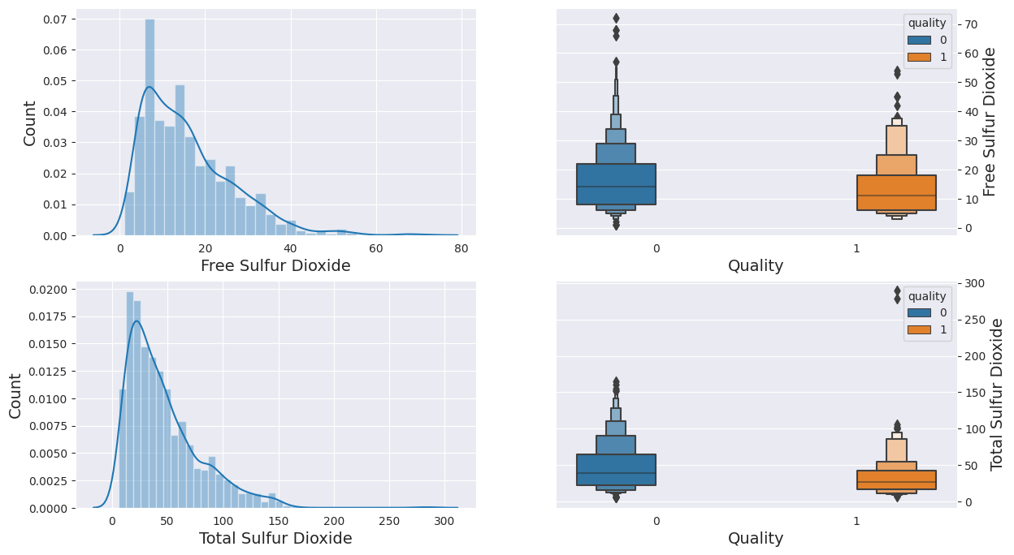
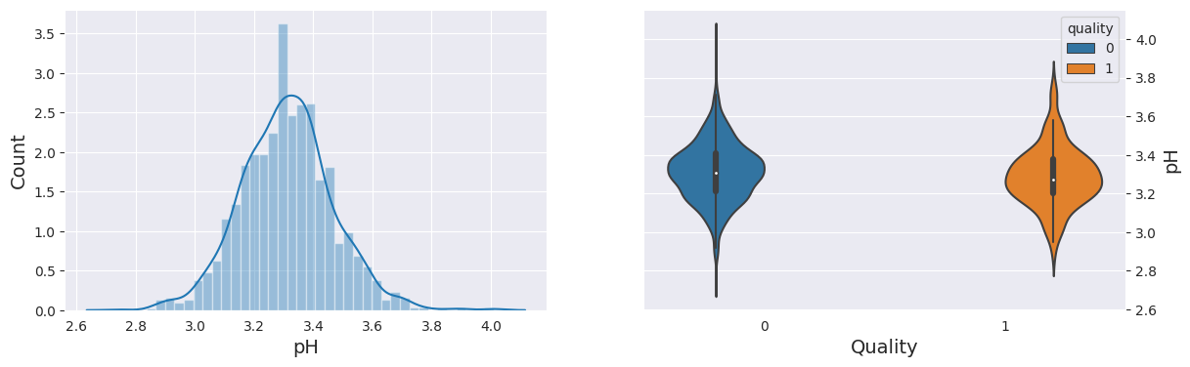
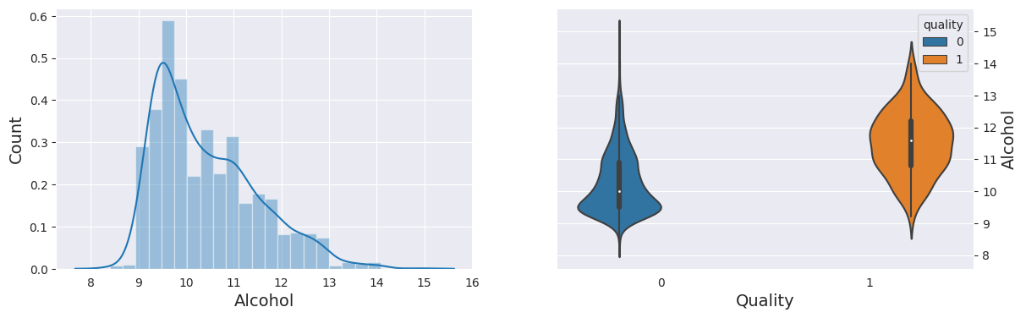
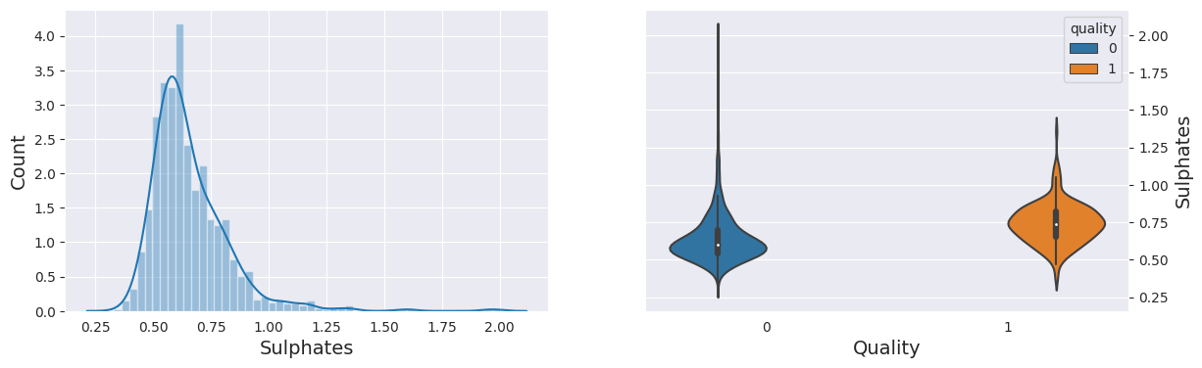
Data Visualization

Slide 10
Data Inferences
Fixed Acidity Distribution and Violin Plot by Quality:
does not show a clear trend with respect to wine quality.
Volatile Acidity Distribution and Violin Plot by Quality:
tends to decrease with higher wine quality.
Citric Acid Distribution and Boxen Plot by Quality:
Citric acid levels tend to slightly increase with higher wine quality.
Residual Sugar Distribution and Violin Plot by Quality:
does not show a clear trend with respect to wine quality.
Chlorides Distribution and Violin Plot by Quality:
tend to decrease with higher wine quality.

Slide 11
Data Inferences
Free and Total Sulfur Dioxide Distribution and Boxen Plots by Quality:
Both free and total sulfur dioxide levels do not show a clear trend with respect to wine quality.
Density Distribution and Violin Plot by Quality:
does not show a clear trend with respect to wine quality.
pH Distribution and Violin Plot by Quality:
do not show a clear trend with respect to wine quality.
Sulphates Distribution and Violin Plot by Quality:
tend to slightly increase with higher wine quality.
Alcohol Distribution and Violin Plot by Quality:
tend to slightly increase with higher wine quality.

Slide 12
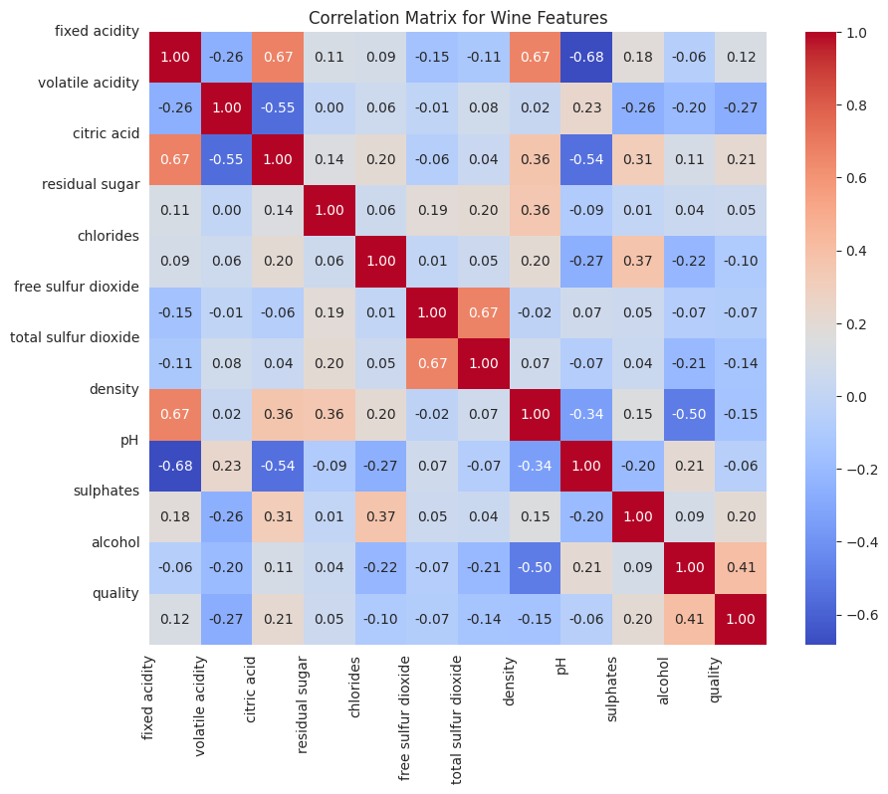
Variable Correlation Matrix

Slide 13
Data Inferences
Alcohol concentration and pH are both favourably connected with wine quality. This implies that higher alcohol content and lower pH wines are generally evaluated as being of higher quality.
Citric acidity and fixed acidity have a positive correlation. This is so because the grape variety and the growth environment have an impact on both acidity measurements.
Total acidity and volatile acidity have a negative relationship. This implies that wines tend to have lower overall acidity and more volatile acidity.
Density and residual sugar have a favourable relationship. Because sugar is denser than water, this is the case.
Free sulfur dioxide and total sulfur dioxide are positively correlated with each other.
This is because free sulfur dioxide is a byproduct of the winemaking process and total sulfur dioxide is the sum of free and bound sulfur dioxide.

Slide 14
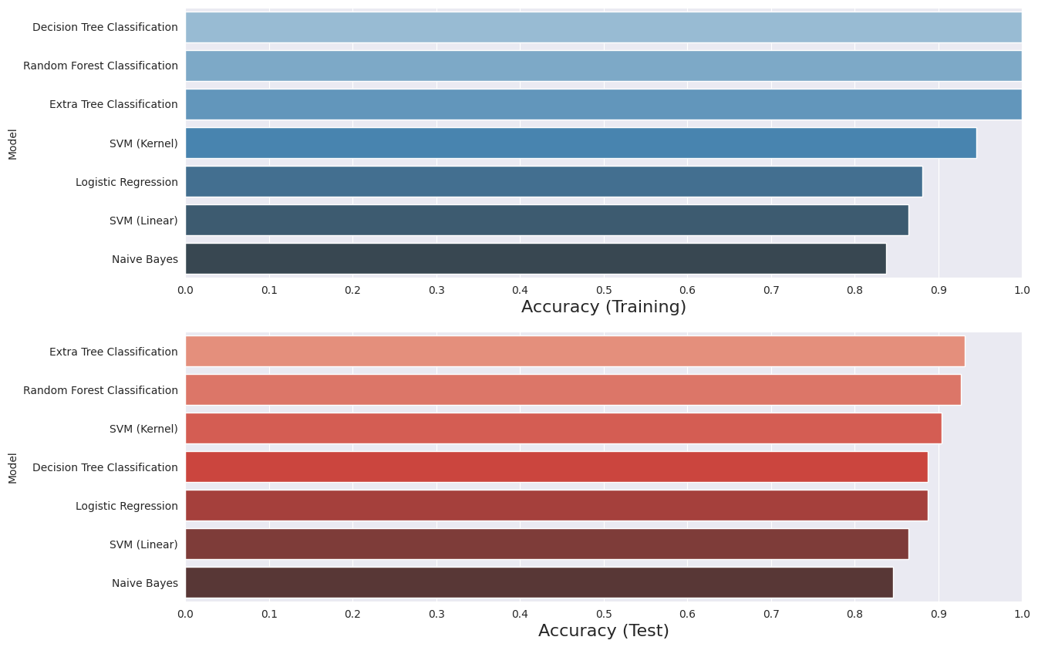
Model Accuracy
It generates side-by-side bar plots to visualize and compare model accuracies (training and testing) for different machine learning models, aiding in model evaluation and selection based on their performance.

Slide 15
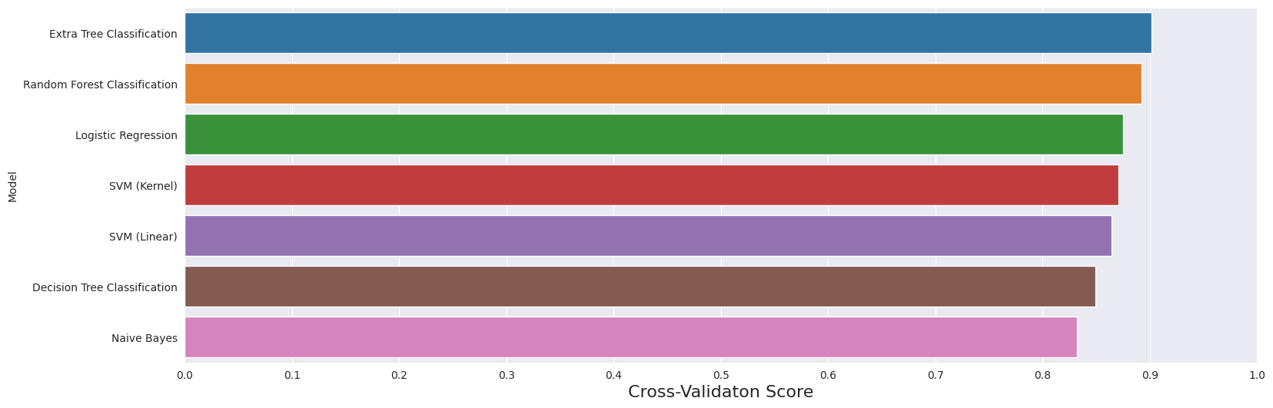
Model Comparison
It generates a bar plot to visualize the model performance based on cross-validation scores, allowing a comparison of how well each model generalizes to unseen data during training.

Slide 16
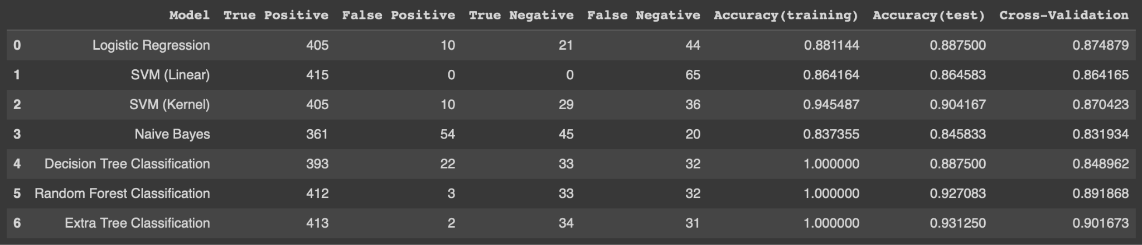
Model Comparison
It creates a pandas DataFrame named 'predict' with columns representing different evaluation metrics and performance scores for machine learning models, enabling organized tracking and comparison of model performance.

Slide 17
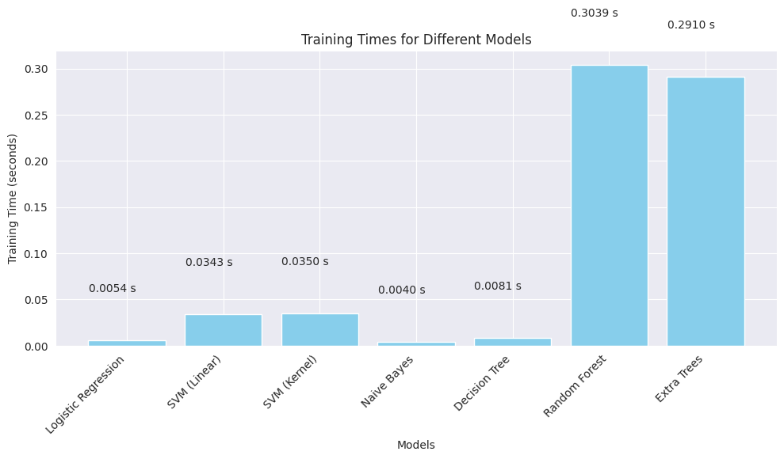
Model Comparison
It generates a bar chart showcasing the training times (in seconds) for various machine learning models, allowing a quick comparison of the computational efficiency required for training each model.

Slide 18


